Slide 1
Data Visualization - COVID19
Sam Hoadley, Gurjinder Singh, Ian Czech

Slide 2
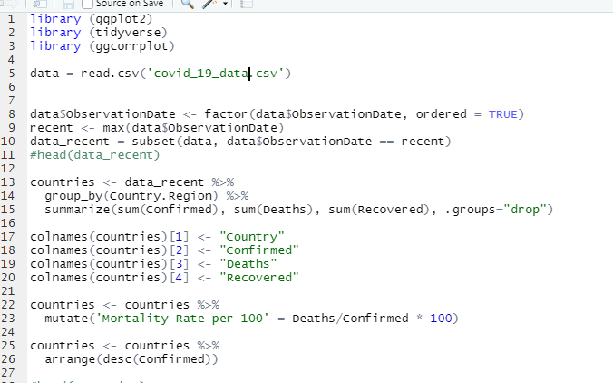
Code

Slide 3
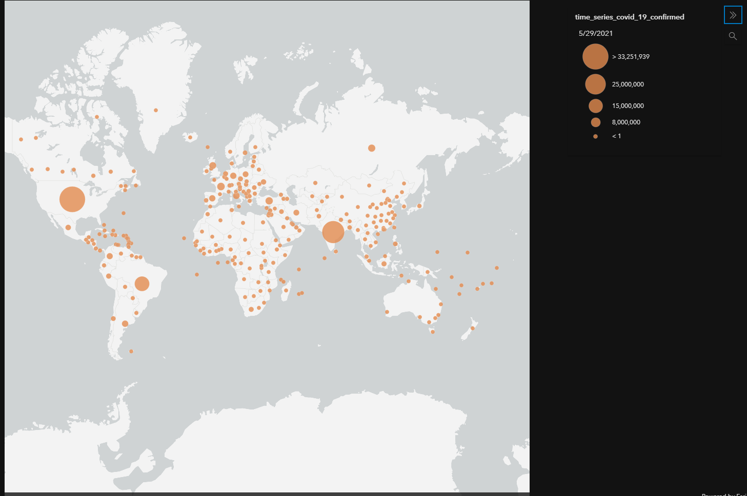
Worldwide Confirmed Cases as of 5/29/21

Slide 4
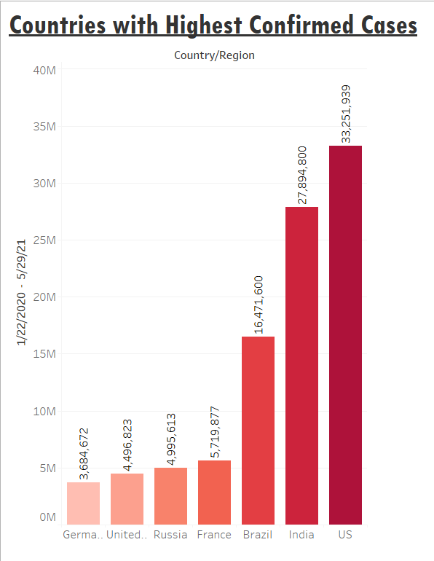
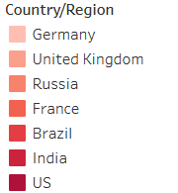
Above we have a bar graph with the countries in ascending order
We can see as time passed the number of confirmed cases increased through the given countries over time

Slide 5
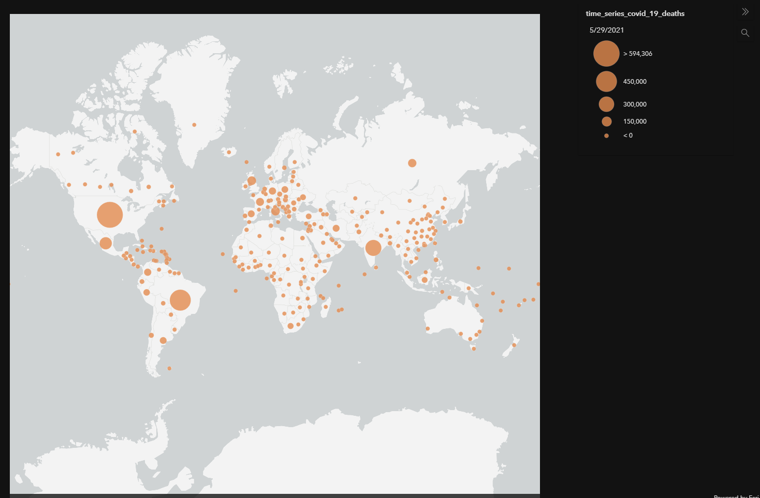
Worldwide Confirmed Deaths as of 5/29/21

Slide 6
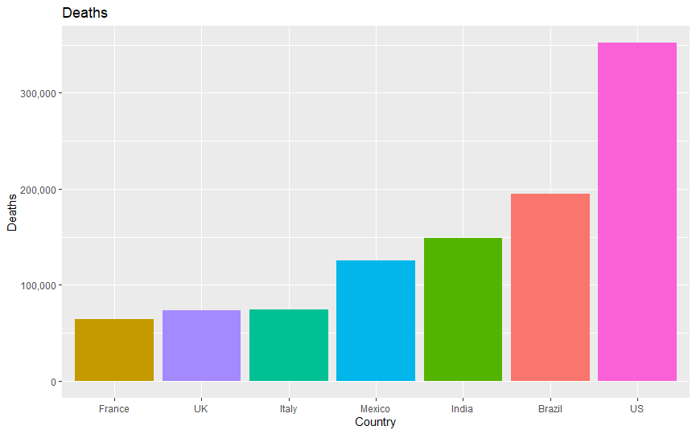
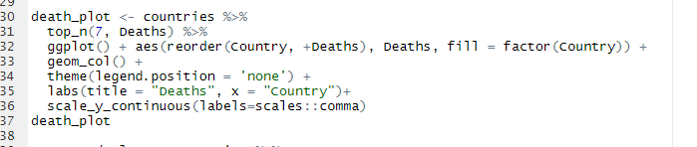
Top country deaths

Slide 7
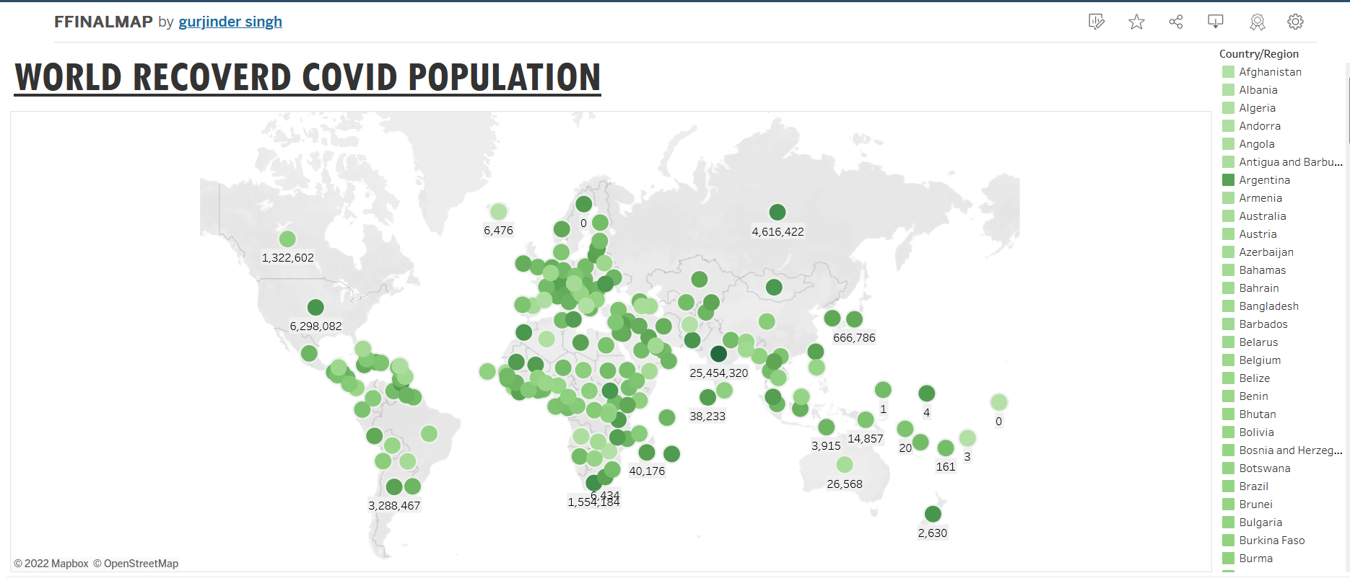
Countries around the world are labeled with the amount of recovered cases
Showing the countries that had the highest recovery rates

Slide 8
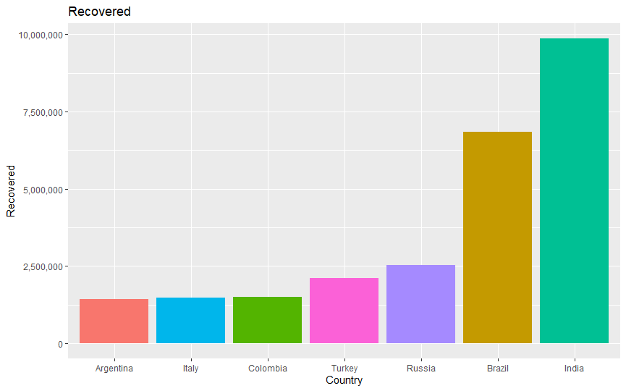
Top country recovered

Slide 9
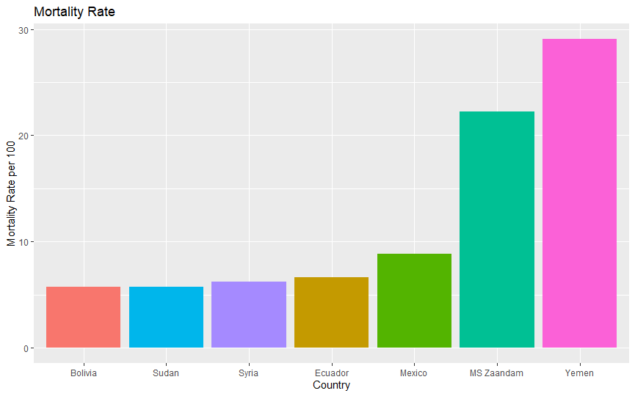
Top country mortality rate

Slide 10
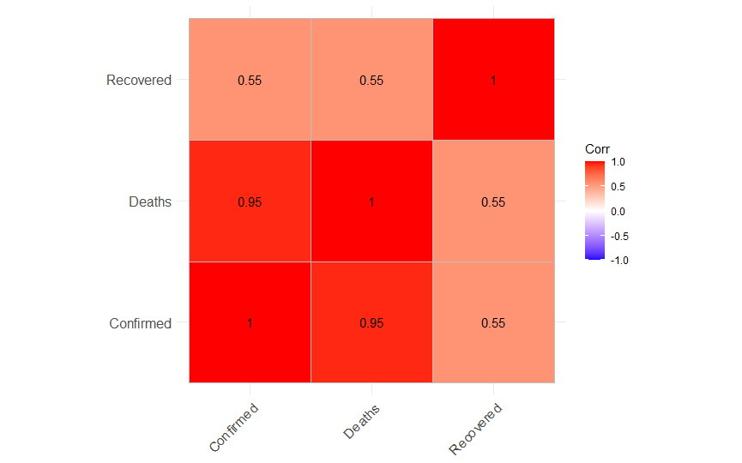
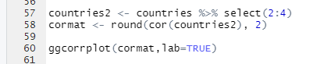
Correlation plot

Slide 11
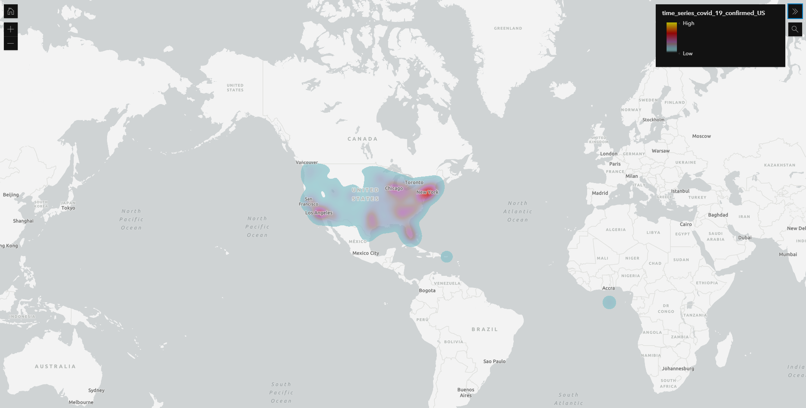
US Confirmed Cases as of 5/29/21

Slide 12
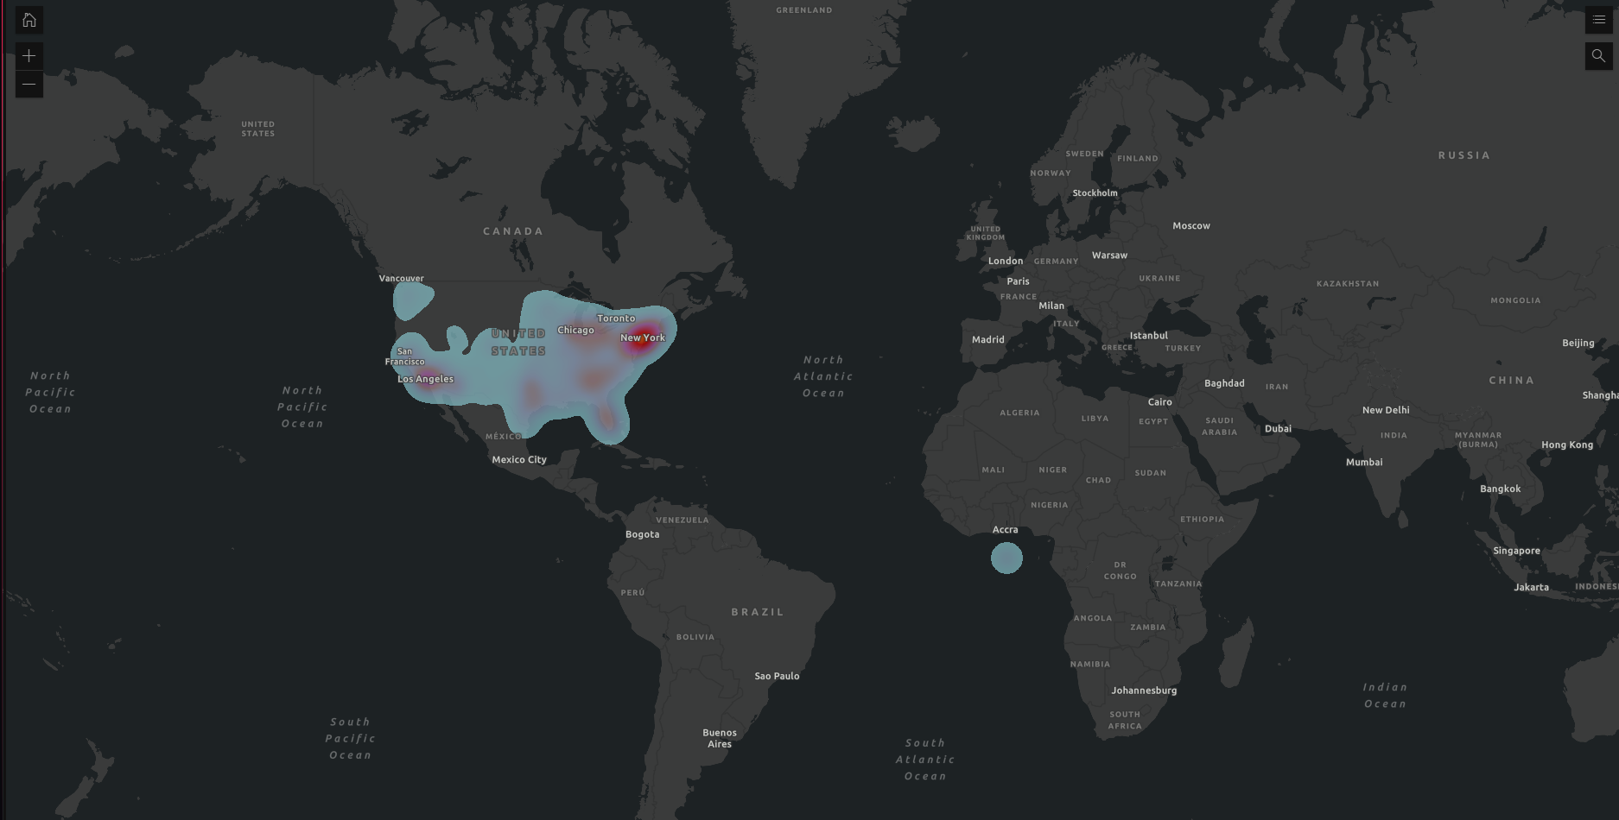
US Confirmed Deaths as of 5/29/21

Slide 13
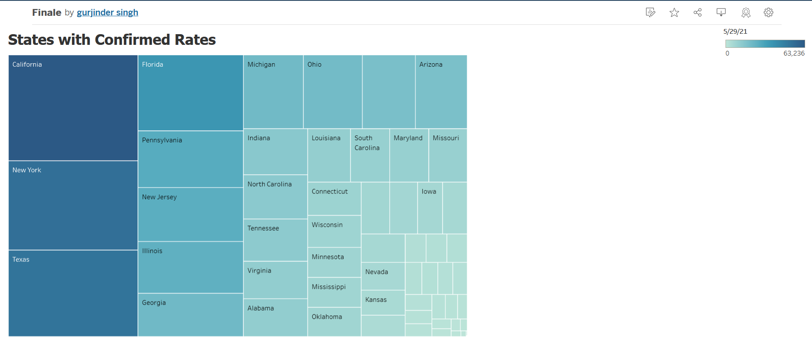
Above we have a tree graph with the countries who have the highest to lowest confirmed cases
States with the highest confirmed rates are large with the darker shades vs the lower confirmed rate countries which are smaller and lighter shaded.

Slide 14
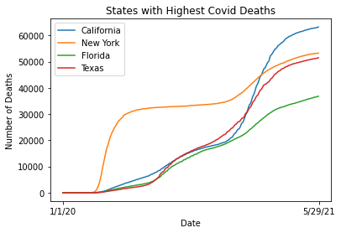
Above we have a line graph with the 4 states that show the highest covid deaths in the USA
We can see as time passes the number of deaths increase through the given states

Slide 15
Conclusions
Countries with the most confirmed and deaths related to COVID-19 are: USA, Brazil, and India.
Countries with the most recovered are India and Brazil
The country with the highest mortality rate per 100 citizens is Yemen
A high density of confirmed cases and deaths in the US are centered around New York, California, Florida, and Texas
Overall, based on the data, a majority of people that contracted COVID-19 died, rather than recovered - however, this is based on some incomplete/unreported data

